Slide 1
CONFIDENTIAL • CO-COUNSEL & REFERRAL OVERVIEW
SPACE HEATER
FIRE CASE?
Refer it. We try them.
Sunbeam, Holmes, Patton, Bionaire, Mr. Coffee, Rival, Oster — and other radiant quartz tower heaters that ignited bedding, drapery, or clothing.
SUNBEAM BRAND FAMILY
Holmes • Sunbeam
Patton • Bionaire
Mr. Coffee • Rival
Oster • Crock-Pot
Coleman • FoodSaver
$58.65M verdict in Shinedling v. Sunbeam Products ($46.92M net after apportionment). Same demonstratives. Same experts. Same playbook. Ready to deploy in your case.
(Newell Brands subsidiaries)
THE HOMAMPOUR LAW FIRM, PC • ARASH HOMAMPOUR, FOUNDING PARTNER
(323) 252-7921 • arash@homampour.com • homampour.com

Slide 2
WHY REFER A SPACE HEATER CASE TO US
We have already tried it, won it, and held the verdict on appeal.
01
02
03
TRIED. WON. AFFIRMED.
EXPERTS AND DEMONSTRATIVES READY
FAIR REFERRAL FEES
Shinedling v. Sunbeam Products — $58.65M jury verdict ($46.92M net) against the manufacturer of a Holmes radiant quartz heater that ignited a bed and killed a sleeping mother of three. The roadmap exists.
Origin/cause, heat-transfer, human factors, economist, and life-care experts already engaged on this exact product family. The 3D heater renderings, temperature exhibits, and manual blow-ups in this deck are court-tested.
CRPC Rule 1.5.1-compliant written referral agreements. Co-counsel arrangements available where you want to stay involved. We carry the costs.
THE HOMAMPOUR LAW FIRM, PC
02 / 25
15303 Ventura Blvd, Suite 1450, Sherman Oaks, CA 91436 • (323) 252-7921 • homampour.com

Slide 3
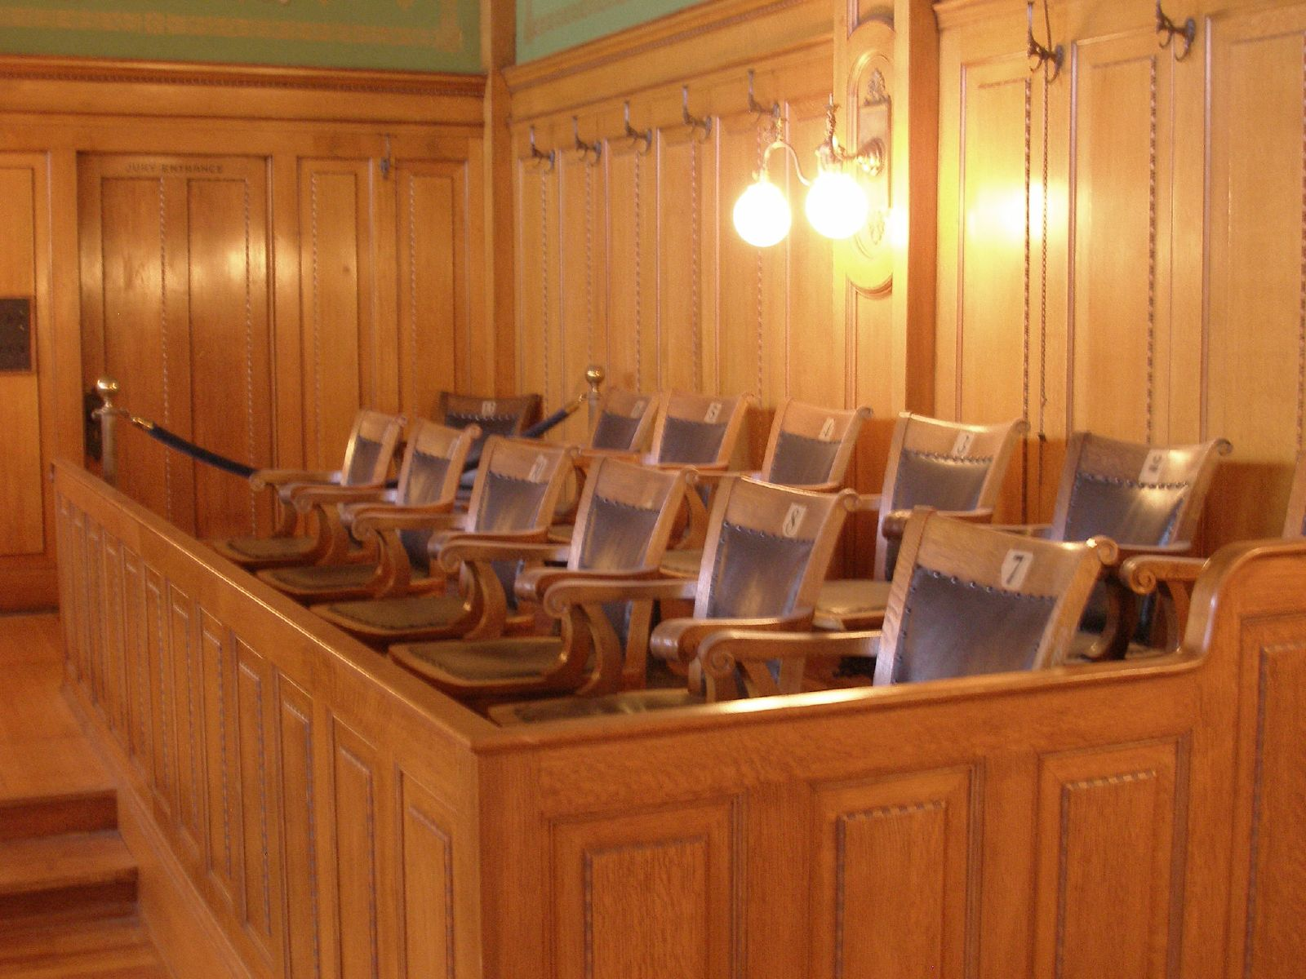
WHY THIS WORKS
How demonstrative graphics win product-defect cases.
01
SHOW, DO NOT TELL
A jury cannot picture 1,200° F. They can see a glowing red bar igniting fabric. The 3D renderings on the next slides did the work expert testimony alone could not.
02
LET THE DEFENDANT TESTIFY
The most damaging exhibit is the manufacturer's own manual highlighted on the screen. "AUTO SAFETY SHUT-OFF" in their words, then the fire-scene photo next to it.
03
ANCHOR WITH ONE NUMBER
The 124° vs 1,200° bar chart is the case. One picture, one comparison, one autoignition line at 450° — and the defect is undeniable.
04
REPEAT THE FRAME
An empty jury box. Twelve people who do not yet know what a radiant heater is. Your job is to make them see it.
The same color, the same heater silhouette, the same red glow across opening, science, manuals, and closing. The jury learns the visual language.
THE HOMAMPOUR LAW FIRM, PC
03 / 25
15303 Ventura Blvd, Suite 1450, Sherman Oaks, CA 91436 • (323) 252-7921 • homampour.com

Slide 4
THE RESULT
Shinedling v. Sunbeam Products
$58.65M
$46.92M
Plaintiffs' jury verdict against Sunbeam Products for a radiant quartz tower heater that ignited a bed and killed a sleeping mother of three.
Net recovery after 20% comparative-fault apportionment. Tried in the U.S. District Court, Central District of California.
Same heater family. Same defect theory. Same demonstrative kit. Ready to deploy in your case.
THE HOMAMPOUR LAW FIRM, PC
04 / 25
15303 Ventura Blvd, Suite 1450, Sherman Oaks, CA 91436 • (323) 252-7921 • homampour.com

Slide 5
INTAKE — WHAT TO LOOK FOR
You probably have one of these cases. Here is how to spot it.
THE FACT PATTERN
CALL US BEFORE YOU PASS
The product
Pre-suit preservation matters more here than almost any case.
Tall, narrow tower heater with a glowing red vertical bar visible through a metal grille. Marketed as "radiant," "quartz," or "infrared."
The brand
Holmes, Sunbeam, Patton, Bionaire, Rival, Oster, or Mr. Coffee. Big-box retail. Often a holiday-season purchase.
Locate and preserve the heater — even if heat-damaged.
Photograph the scene before any cleanup; document the fabric.
The ignition
A blanket, clothing, drapery, pet bed, or paper falls onto or against the front grille. Within minutes the fabric ignites.
Get the model number from the unit, box, or receipt.
Hold the fire department report and any insurer photos.
The damage
Bedroom or apartment fire, often overnight. Severe burns, smoke inhalation, wrongful death — frequently children or elderly.
Do not let the insurer subrogate without our involvement.
The defense
Arash Homampour
"User error." "The heater had tip-over and overheat protection." All of which we have already beaten.
(323) 252-7921 • arash@homampour.com
THE HOMAMPOUR LAW FIRM, PC
05 / 25
15303 Ventura Blvd, Suite 1450, Sherman Oaks, CA 91436 • (323) 252-7921 • homampour.com

Slide 6
PART ONE
THE SCIENCE
Two heaters. Two physics. One of them sets fabric on fire.
06 / 25

Slide 7
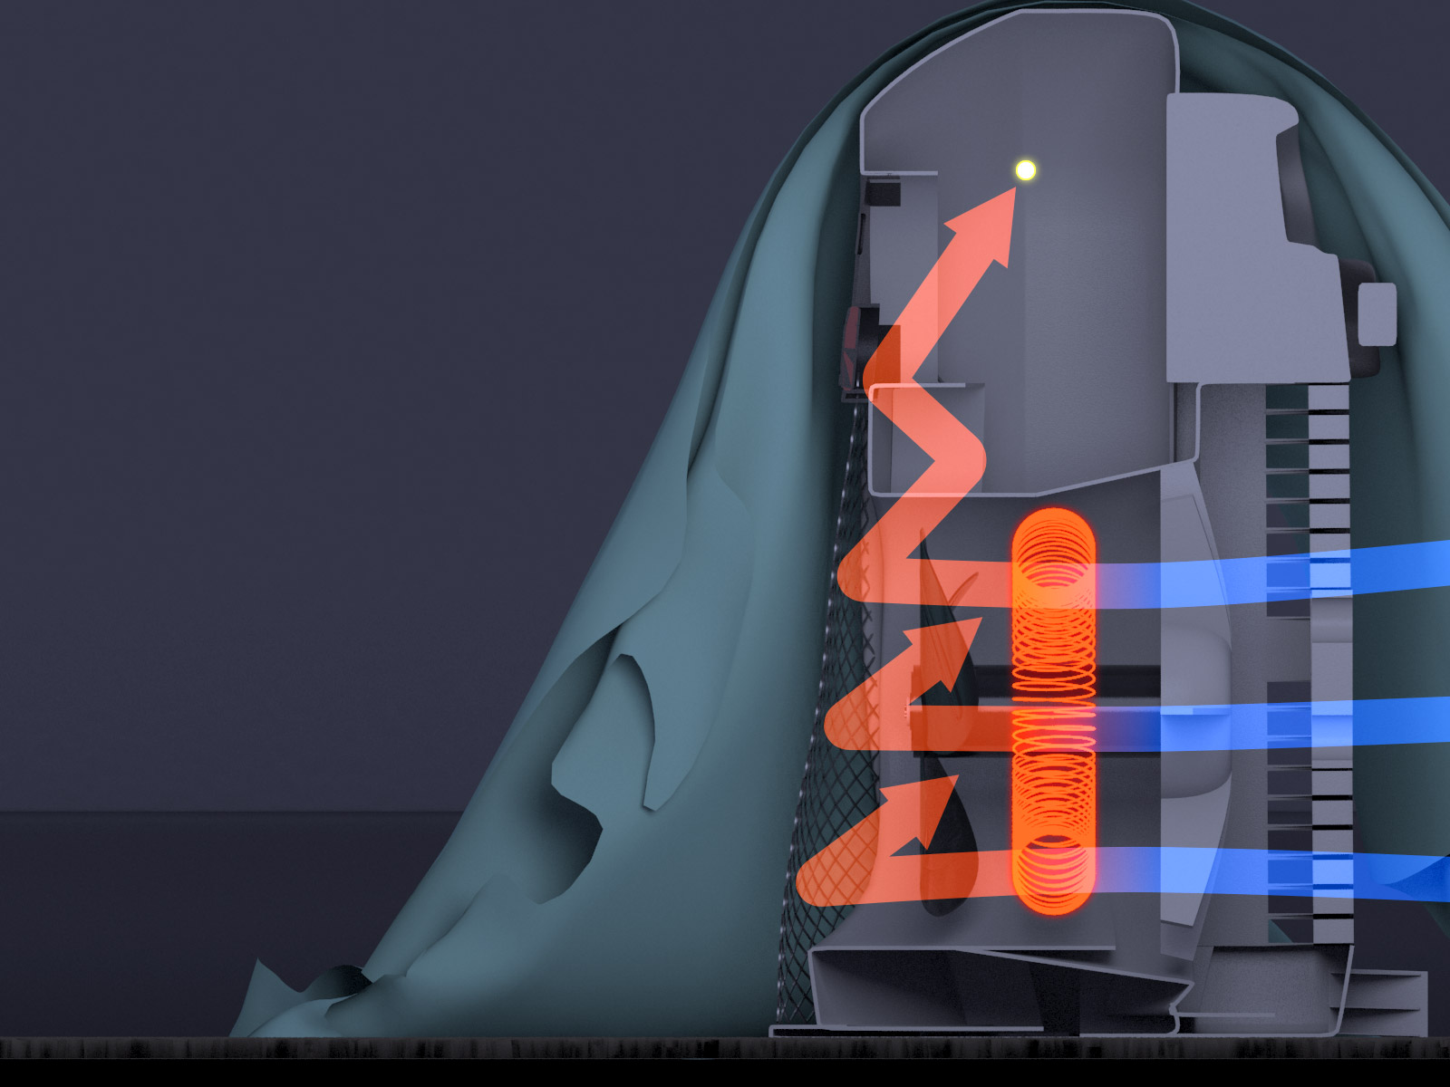
HOW A FORCED-AIR HEATER WORKS
It blows warm air. Touch the fabric and it gets warm, not hot.
FORCED AIR — convection
Heat moves via moving air.
A fan pulls cool room air in, pushes it across a low-temperature heating element, and blows the warmed air out the top. When fabric drapes across the unit, the airflow is blocked — the fabric stays well below ignition temperature.
124° F
Maximum surface temperature
of a forced-air heater under load
3D cutaway demonstrative from Shinedling closing argument.
THE HOMAMPOUR LAW FIRM, PC
07 / 25
15303 Ventura Blvd, Suite 1450, Sherman Oaks, CA 91436 • (323) 252-7921 • homampour.com

Slide 8
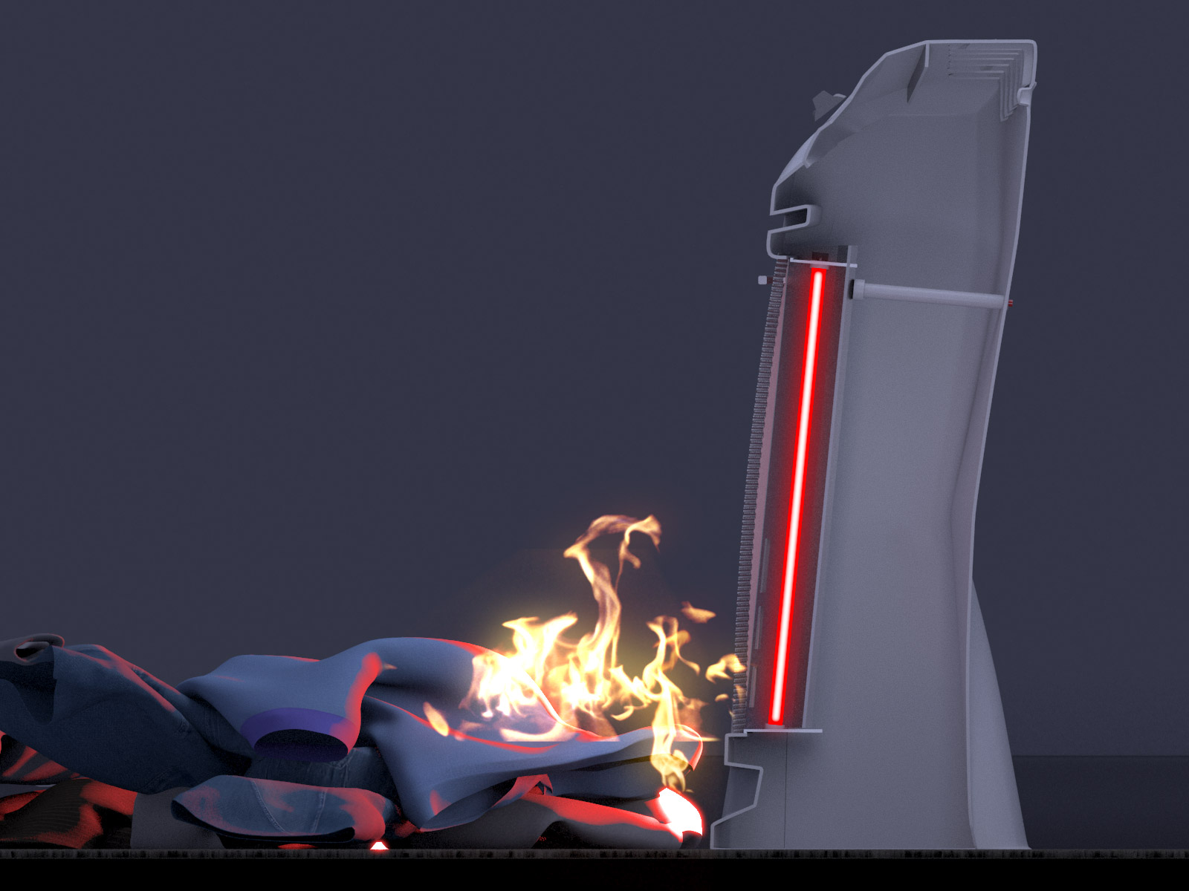
HOW A RADIANT QUARTZ HEATER WORKS
It glows. Anything that touches the glow ignites.
RADIANT QUARTZ — infrared
Heat radiates through space.
A glowing quartz tube emits infrared radiation. There is no airflow protecting the element. Anything in front of the grille — a sleeve, a comforter, a curtain — absorbs the radiant energy directly and heats up until it ignites.
1,200° F
Surface temperature of the quartz element in a Holmes radiant tower heater.
Radiant heater 3D demonstrative — Shinedling closing argument.
THE HOMAMPOUR LAW FIRM, PC
08 / 25
15303 Ventura Blvd, Suite 1450, Sherman Oaks, CA 91436 • (323) 252-7921 • homampour.com

Slide 9
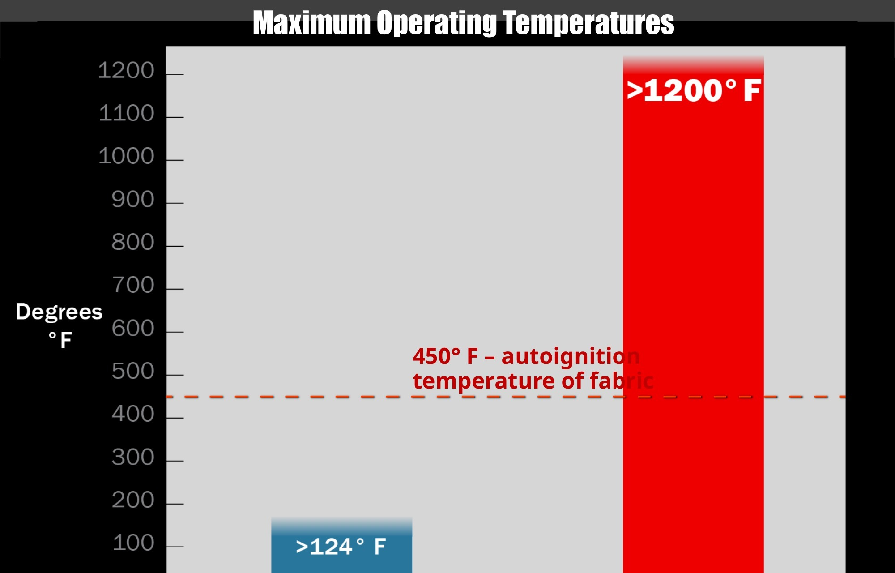
THE COMPARISON THE JURY REMEMBERS
One picture, one comparison, one autoignition line.
1,200° F
Radiant element
temperature
THE TAKEAWAY
450° F
Almost 10×
the forced-air
maximum.
Autoignition
temperature of fabric
450° F — autoignition
temperature of fabric
Nearly 3× the
autoignition line
of household fabric.
124° F
Forced-air
maximum surface
THE HOMAMPOUR LAW FIRM, PC
09 / 25
15303 Ventura Blvd, Suite 1450, Sherman Oaks, CA 91436 • (323) 252-7921 • homampour.com

Slide 10
PART TWO
IN THEIR OWN WORDS
The defense will tell the jury the heater was safe. The manufacturer already told you it wasn't.
10 / 25

Slide 11
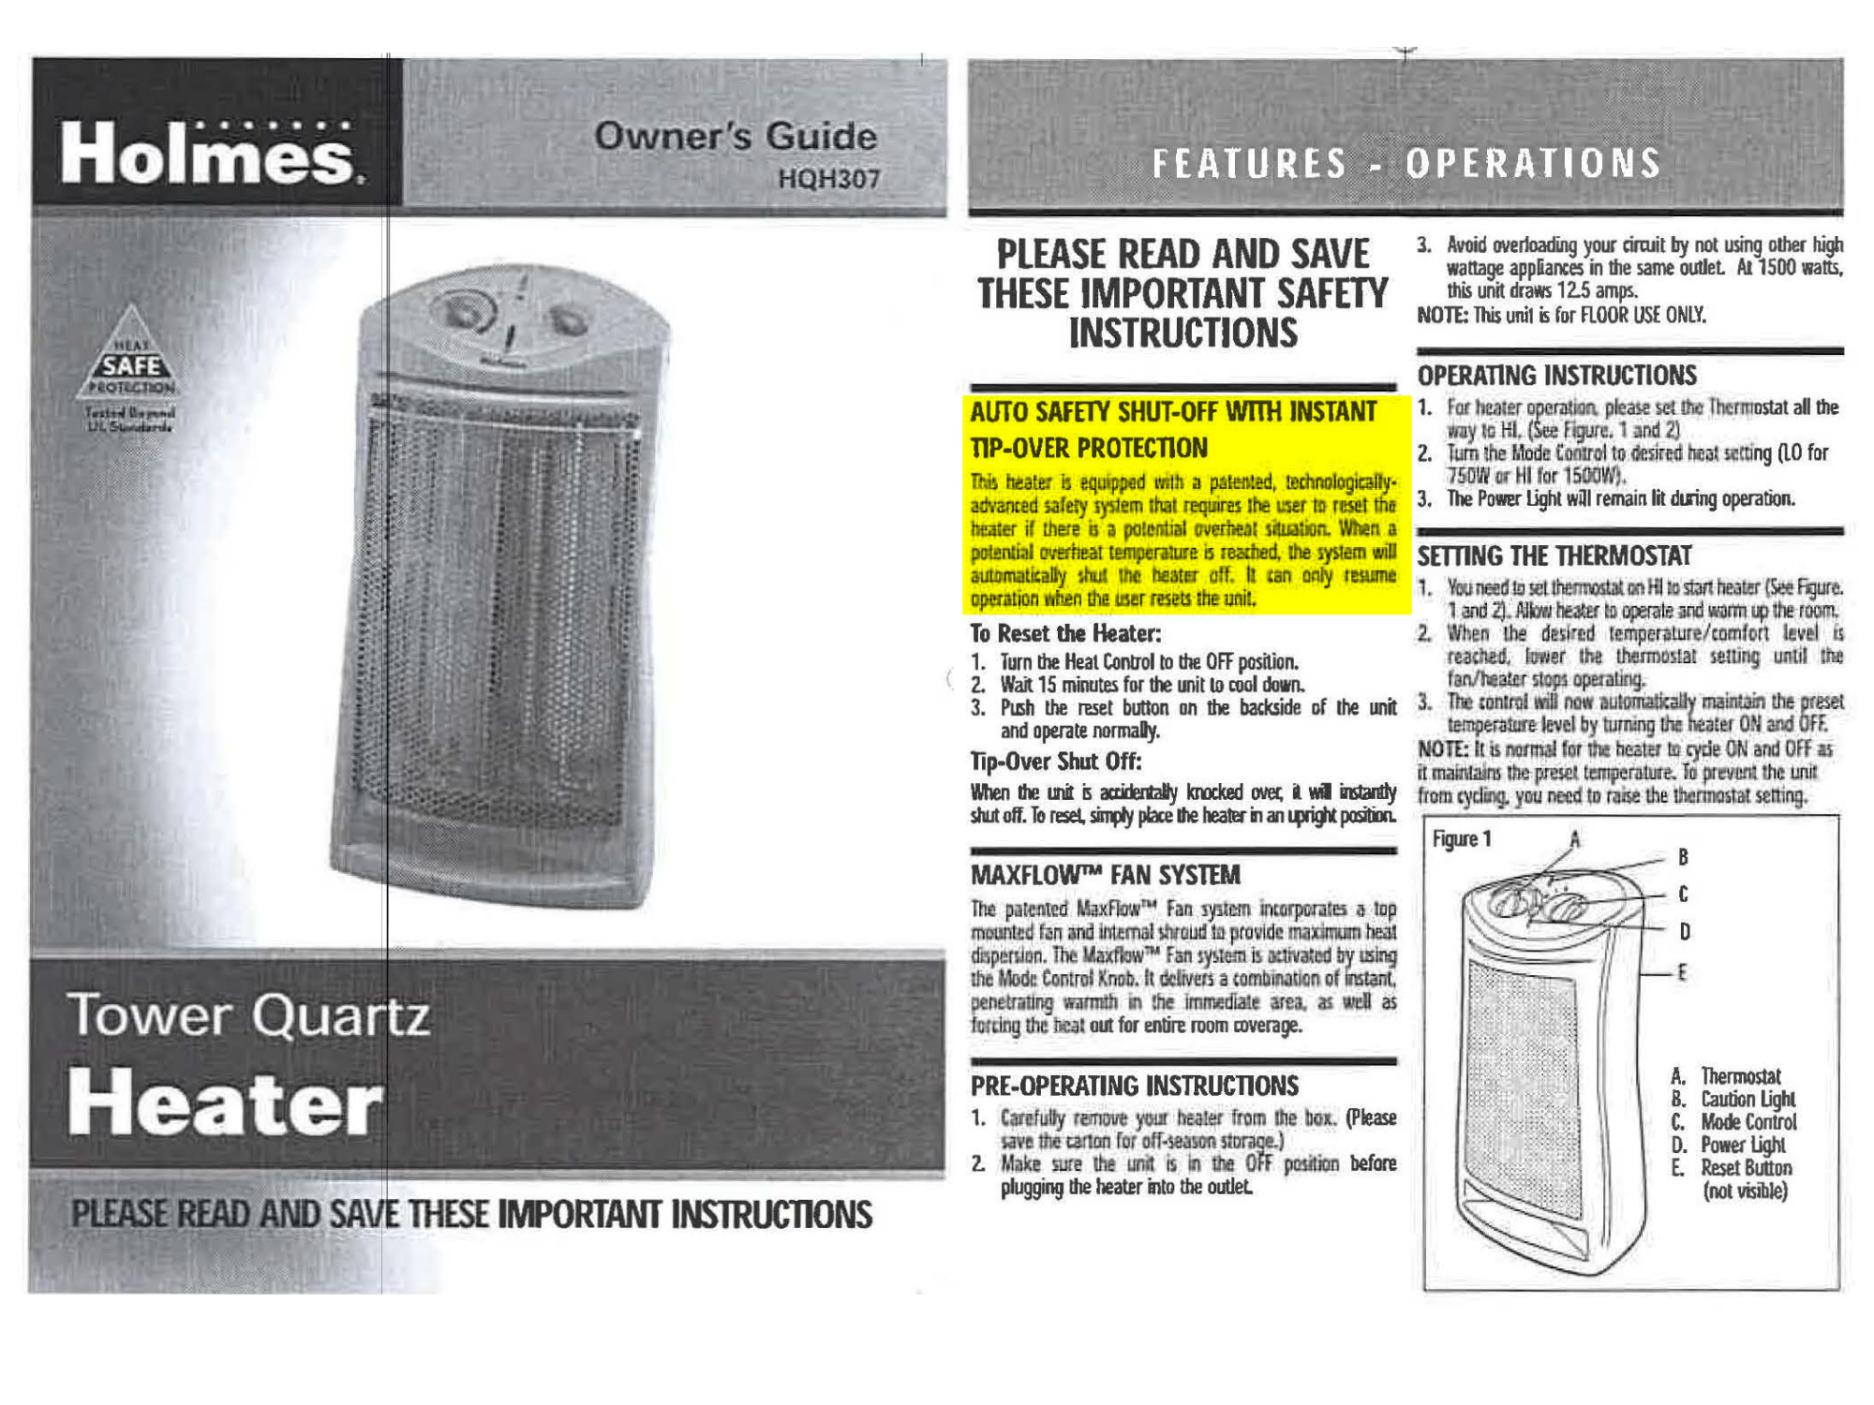
EXHIBIT — HOLMES HQH307 OWNER'S GUIDE
"AUTO SAFETY SHUT-OFF WITH INSTANT TIP-OVER PROTECTION."
THE DEFENSE WILL ARGUE
"The user should have known not to put bedding near the heater."
THE EXHIBIT REPLIES
Holmes told the consumer the heater would shut itself off in a "potential overheat situation." This unit didn't. That is a manufacturer's broken promise — not user error.
THE HOMAMPOUR LAW FIRM, PC
11 / 25
15303 Ventura Blvd, Suite 1450, Sherman Oaks, CA 91436 • (323) 252-7921 • homampour.com

Slide 12
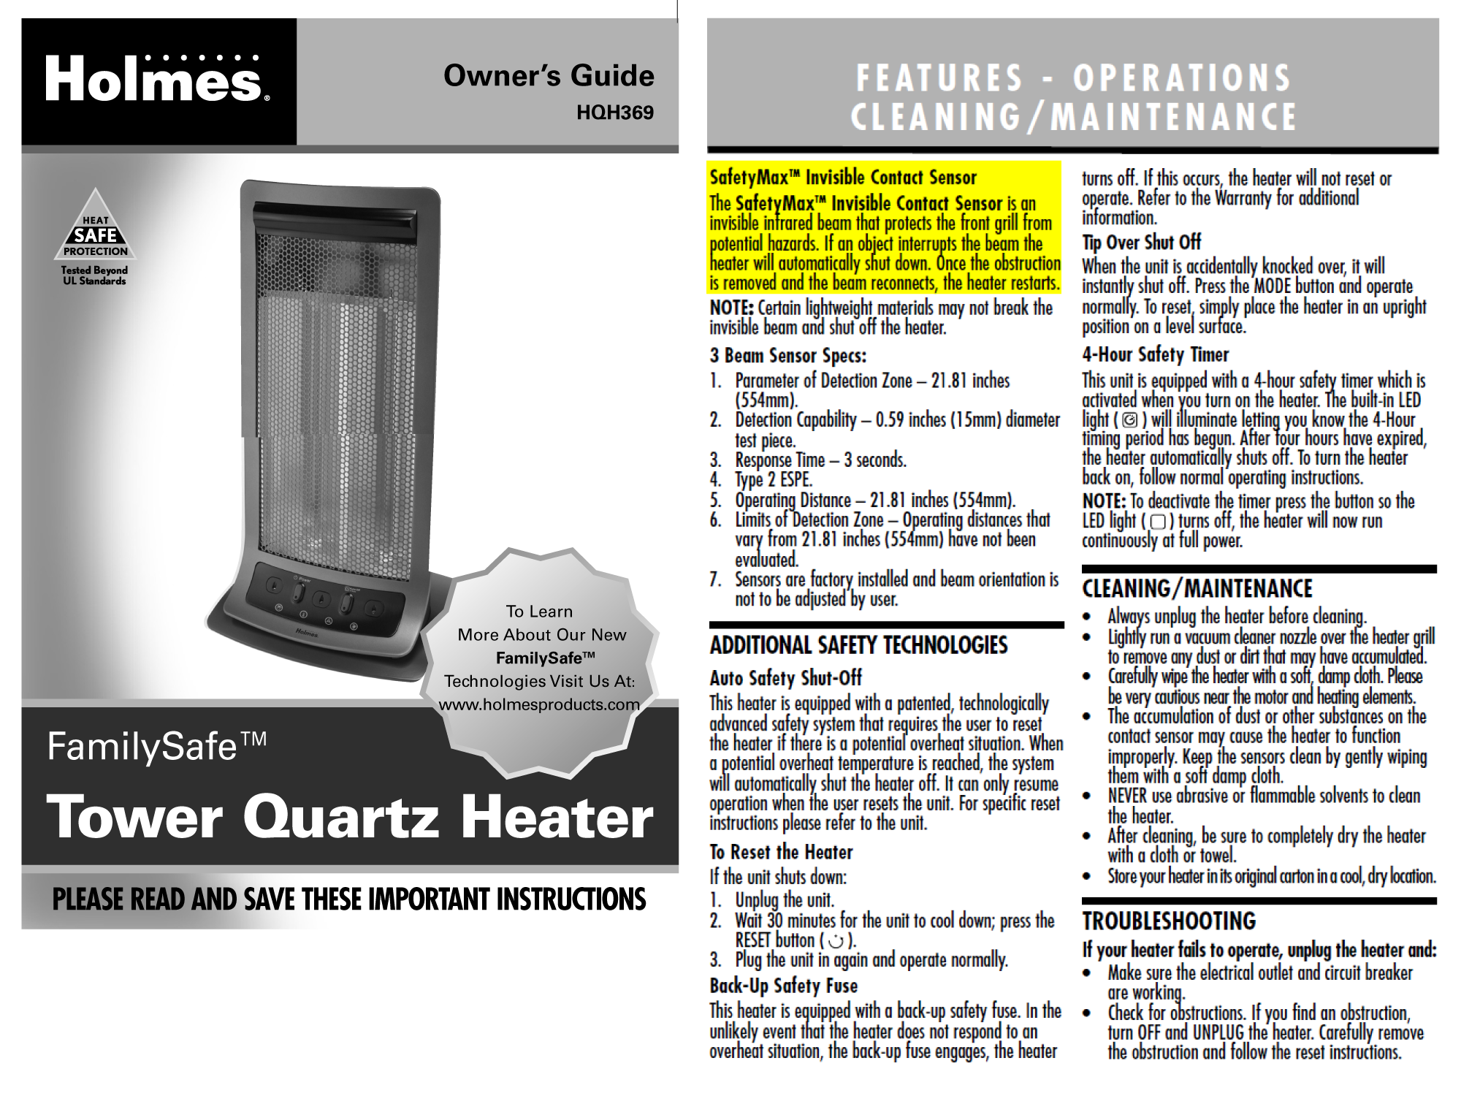
EXHIBIT — HOLMES HQH369 "FAMILYSAFE"
"SafetyMax™ Invisible Contact Sensor." Marketed as family-safe.
THE MARKETING
"FamilySafe™" — a brand name chosen to make a parent believe the heater is safe to use in a child's bedroom.
THE REALITY
"Certain lightweight materials may not break the invisible beam and shut off the heater." Buried on page two. The branding promised safety the sensor cannot deliver.
THE HOMAMPOUR LAW FIRM, PC
12 / 25
15303 Ventura Blvd, Suite 1450, Sherman Oaks, CA 91436 • (323) 252-7921 • homampour.com

Slide 13
PART THREE
THE ARGUMENT
The frame that won Shinedling. The frame that wins your case.
13 / 25

Slide 14
LEGAL FRAMEWORK
Strict products liability — California consumer expectations test.
01
02
03
DESIGN DEFECT
FAILURE TO WARN
MANUFACTURING / TESTING
A radiant quartz heater that reaches 1,200° F at the grille fails the consumer expectations test as a matter of common sense. A reasonable buyer does not expect a household appliance sold for bedroom use to ignite a blanket.
Warnings buried on page two of an owner's guide cannot overcome a "FamilySafe" brand on the box. Risk-utility weighs against any warning that contradicts the marketing.
Where the unit's own tip-over or overheat sensor failed, plaintiff prevails on a malfunction theory without needing to identify the specific component defect.
THE HOMAMPOUR LAW FIRM, PC
14 / 25
15303 Ventura Blvd, Suite 1450, Sherman Oaks, CA 91436 • (323) 252-7921 • homampour.com

Slide 15
JURY INSTRUCTION ANCHOR
CACI 1203 — Consumer Expectation Test. Read it. Then show the chart.
CACI No. 1203 — Strict Liability — Design Defect — Consumer Expectation Test
"A product is defective in design if it failed to perform as safely as an ordinary consumer would have expected it to perform when used in an intended or reasonably foreseeable manner."
THE "REASONABLY FORESEEABLE" USES THE JURY WILL HEAR ABOUT
Heater placed in a bedroom — exactly as marketed.
Bedding draped near or against the unit — common in cold-weather use.
Used overnight while occupants sleep — the marketed scenario.
Used by elderly or families with children — the named target market.
THE HOMAMPOUR LAW FIRM, PC
15 / 25
15303 Ventura Blvd, Suite 1450, Sherman Oaks, CA 91436 • (323) 252-7921 • homampour.com

Slide 16
CLOSING ARGUMENT FRAME
DECEPTION — the template that drove the Shinedling verdict.
D
Design defect
A 1,200° glowing element open to fabric is not a design — it is a fire starter with a fan.
E
Expected to be safe
"FamilySafe." "Auto Safety Shut-Off." The buyer relied on every one of those words.
C
Concealed risk
The qualifying language was buried where no parent would find it.
E
Element failure
Tip-over sensor, overheat sensor, contact beam — each failed in this fire.
P
Profit over safety
A working contact sensor that fires on a cotton sheet costs pennies.
T
Tragedy was foreseen
The consequence is named for the jury. Your case has a name, too. Use it.
I
Industry standard
Forced-air heaters do the same job at 124°. The safer design existed the entire time.
O
Own words convict
The exhibit binder closes with the manufacturer's manual highlighted in yellow.
N
Now — your verdict
Damages are not a windfall. They are the only language a manufacturer hears.
THE HOMAMPOUR LAW FIRM, PC
16 / 25
15303 Ventura Blvd, Suite 1450, Sherman Oaks, CA 91436 • (323) 252-7921 • homampour.com

Slide 17
PART FOUR
THE NUMBER
Building a per-diem economic damages model the jury can verify on a calculator.
17 / 25

Slide 18
BUILDING THE NUMBER
Illustrative damages model for a catastrophic burn case — adjust to the facts.
CATEGORY
COMPONENT
BASIS
AMOUNT
ECONOMIC
Past medical (burn unit, surgeries)
18 months @ documented bills
$1.85M
ECONOMIC
Future medical (life-care plan)
50 yrs × $185,000/yr (PV)
$6.20M
ECONOMIC
Lost earning capacity
Economist — pre-injury trajectory
$3.40M
NONECONOMIC
Past pain and suffering
3 yrs @ $1,370/day × 1,095 days
$1.50M
NONECONOMIC
Future pain and suffering
47 yrs @ $875/day (life expectancy)
$15.00M
NONECONOMIC
Past + future disfigurement
Permanent — separate category
$5.00M
PUNITIVE
Punitive damages
CC §3294 — ratio to compensatory
Jury
COMPENSATORY TOTAL (PRE-PUNITIVES)
$32.95M
Illustrative model only — adjust to your facts. Catastrophic burn cases regularly support 9-figure totals; non-economic damages are not capped in product-liability actions.
THE HOMAMPOUR LAW FIRM, PC
18 / 25
15303 Ventura Blvd, Suite 1450, Sherman Oaks, CA 91436 • (323) 252-7921 • homampour.com

Slide 19
WHAT THE JURY ACTUALLY AWARDED
Shinedling per-plaintiff damages — wrongful death of a sleeping mother of three.
PLAINTIFF
DIRECT-INJURY ED
BYSTANDER ED
WRONGFUL DEATH
TOTAL
Husband
$820K
$6.10M
$3.08M
$9.995M
Daughter (age 12 at trial)
$1.42M
$10.65M
$3.53M
$15.595M
Daughter (age 9 at trial)
$1.48M
$11.10M
$3.53M
$16.105M
Daughter (age 3 at trial)
$1.58M
$11.85M
$3.53M
$16.955M
JURY VERDICT
$58.65M
Net recovery $46.92M after 20% comparative-fault apportionment. ED = emotional distress (past + future combined). Wrongful-death column also combines past + future.
THE HOMAMPOUR LAW FIRM, PC
19 / 25
15303 Ventura Blvd, Suite 1450, Sherman Oaks, CA 91436 • (323) 252-7921 • homampour.com

Slide 20
PART FIVE
USING THE KIT
Where each demonstrative belongs in the trial chronology.
20 / 25

Slide 21
TRIAL DEPLOYMENT
Where each demonstrative goes — and why.
PHASE
GRAPHIC
WHY
OPENING
Forced-air vs radiant 3D side-by-side
Plant the visual language before any expert testifies. The jury starts thinking in your frame.
EXPERT — HEAT TRANSFER
124° / 450° / 1,200° bar chart
Anchor the only three numbers the jury needs to remember. The autoignition line does the work.
CROSS — DEFENDANT WITNESS
Holmes HQH307 + HQH369 manuals (highlighted)
Read the safety language back to the manufacturer. The exhibit testifies for itself.
CLOSING — LIABILITY
Radiant heater + ignited fabric render
The image is the verdict. No words, no expert — the jury already knows.
CLOSING — DAMAGES
Per-diem damages build (slide 18 frame)
Show the calculator math so the jury can verify the number, not invent it.
THE HOMAMPOUR LAW FIRM, PC
21 / 25
15303 Ventura Blvd, Suite 1450, Sherman Oaks, CA 91436 • (323) 252-7921 • homampour.com

Slide 22
PRESERVATION CHECKLIST
Do this in the first 30 days — before evidence walks.
THE PRODUCT
THE SCENE
THE PAPER
Locate and seize the heater (even if heat-damaged).
Order the fire department investigation report.
Original packaging, owner's manual, point-of-sale receipt.
Record model number, serial number, and any UL/ETL marks.
Obtain insurer photos and any subrogation file before settlement.
CPSC database search — prior incidents, recalls.
Chain-of-custody: bag, photograph, log.
Locate the bedding / fabric that ignited.
NEISS injury data for the model line.
Send formal preservation letter to manufacturer and retailer.
Preserve the outlet, cord, and any plug-in timer.
Manufacturer's testing reports via early discovery.
THE HOMAMPOUR LAW FIRM, PC
22 / 25
15303 Ventura Blvd, Suite 1450, Sherman Oaks, CA 91436 • (323) 252-7921 • homampour.com

Slide 23
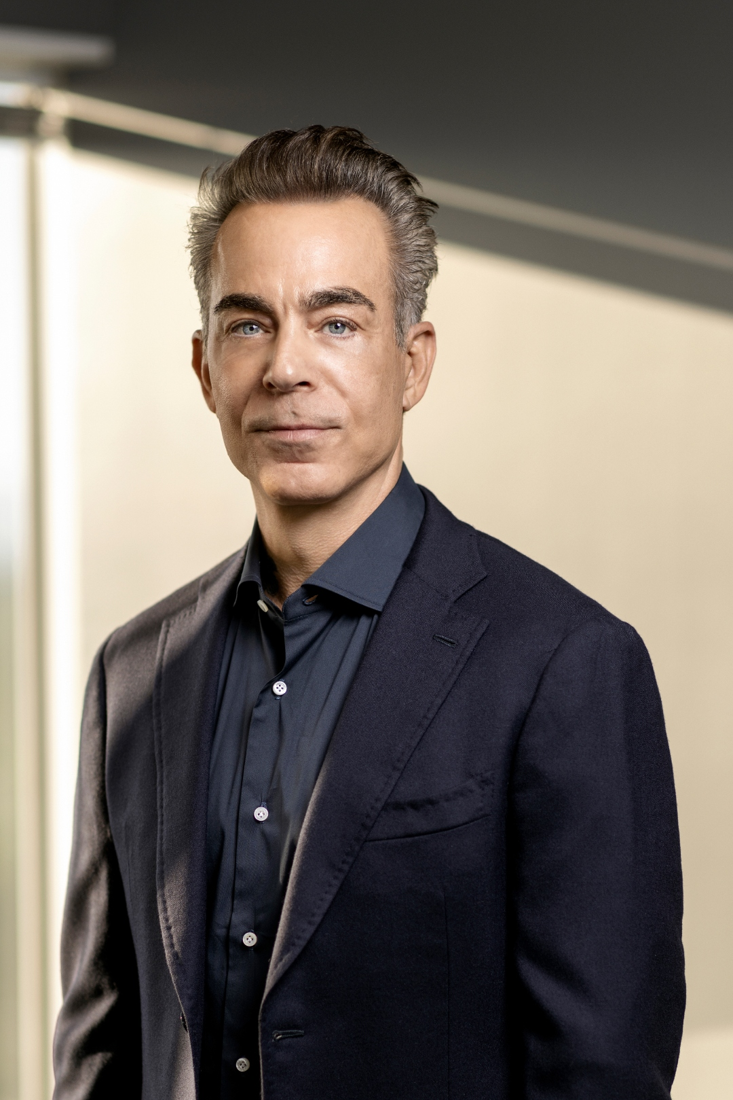
WHO TRIES THE CASE
Arash Homampour — Top 10 Super Lawyer (Southern California), five consecutive years.
ARASH HOMAMPOUR
Founding Partner • Trial Lawyer • Sherman Oaks, CA
Ranked among the Top 10 attorneys in Southern California on the Super Lawyers list — across all practice areas — for five consecutive years. Founder of a twelve-lawyer firm that tries catastrophic injury and wrongful death cases throughout California.
RECORD RESULTS
$104M traumatic brain injury • $65.75M trucking • $58.65M Shinedling v. Sunbeam ($46.92M net) • $38M wrongful death — plus numerous outlier settlements.
NATIONAL HONORS
Law360 Titan of the Plaintiffs Bar (one of 10 nationwide). CAALA Ted Horn Memorial Award (2018). Trial Attorney of the Year — CAALA, OC TLA, Ventura County TLA.
APPELLATE
Successfully briefed and argued before the California Supreme Court.
TEACHING & WRITING
Monthly columnist — LA Daily Journal, Law360, Forbes, Entrepreneur. Mentors trial lawyers. Founded the There Is a Light Foundation (public-service scholarships at Southwestern Law School).
THE HOMAMPOUR LAW FIRM, PC
23 / 25
15303 Ventura Blvd, Suite 1450, Sherman Oaks, CA 91436 • (323) 252-7921 • homampour.com

Slide 24
REFERRAL MECHANICS
How a referral or co-counsel arrangement works.
01
02
CALL OR EMAIL
WRITTEN AGREEMENT — CRPC 1.5.1
A 15-minute call is enough to determine fit. Arash personally takes the call. We sign a confidentiality agreement before facts are shared if you prefer.
A short written referral or co-counsel agreement signed by all attorneys and the client. We do not begin work until the paper is right.
03
04
WE CARRY THE COSTS
YOUR ROLE — YOUR CHOICE
Experts, demonstratives, deposition transcripts, trial tech — all advanced by the firm. The client owes nothing out of pocket.
Pure referral with a fee at resolution, or active co-counsel through trial. We honor whichever arrangement works for your practice and your client.
THE HOMAMPOUR LAW FIRM, PC
24 / 25
15303 Ventura Blvd, Suite 1450, Sherman Oaks, CA 91436 • (323) 252-7921 • homampour.com

Slide 25
IF YOUR CLIENT WAS BURNED BY A RADIANT HEATER —
Call us first.
Holmes • Sunbeam • Patton • Bionaire • Mr. Coffee • Rival • Oster
— and any other quartz tower heater in the Newell / Sunbeam Products portfolio.
PHONE
EMAIL
WEB
(323) 252-7921
arash@homampour.com
homampour.com
THE HOMAMPOUR LAW FIRM, PC • 15303 VENTURA BLVD, SUITE 1450, SHERMAN OAKS, CA 91436
25 / 25
Confidential — for referring counsel only. Not legal advice. Past results do not guarantee future outcomes.

